Slide 1
Exploratory Data Analysis on Heart Disease UCI

Slide 2
Introduction
The purpose of this data analysis is to better understand the health factors that influence a patient's risk of heart disease. To achieve this, an introduction to the data will be provided, along with a graphical analysis of the health factors in the dataset

Slide 3
Dataset Explanation
The Heart Disease Dataset selected for this project comes from the UCI Machine Learning Repository. The dataset consists of 100000 patients’ data, which describe the individual’s health factors and diagnosis of heart disease. The 14 health factors in the dataset used in this project are outlined below.

Slide 4
Feature
1-Age: Age is the most important risk factor in developing cardiovascular or heart diseases, with approximately a tripling of risk with each decade of life. Coronary fatty streaks can begin to form in adolescence. It is estimated that 82 percent of people who die of coronary heart disease are 65 and older. Simultaneously, the risk of stroke doubles every decade after age 55.
2-Sex: Men are at greater risk of heart disease than pre-menopausal women. Once past menopause, it has been argued that a woman’s risk is similar to a man’s although more recent data from the WHO and UN disputes this. If a female has diabetes, she is more likely to develop heart disease than a male with diabetes.
3-Angina (Chest Pain): Angina is chest pain or discomfort caused when your heart muscle doesn’t get enough oxygen-rich blood. It may feel like pressure or squeezing in your chest. The discomfort also can occur in your shoulders, arms, neck, jaw, or back. Angina pain may even feel like indigestion.
4-Resting Blood Pressure: Over time, high blood pressure can damage arteries that feed your heart. High blood pressure that occurs with other conditions, such as obesity, high cholesterol or diabetes, increases your risk even more.
5-Serum Cholesterol: A high level of low-density lipoprotein (LDL) cholesterol (the “bad” cholesterol) is most likely to narrow arteries. A high level of triglycerides, a type of blood fat related to your diet, also ups your risk of a heart attack. However, a high level of high-density lipoprotein (HDL) cholesterol (the “good” cholesterol) lowers your risk of a heart attack.
.

Slide 5
Cont!
6-Fasting Blood Sugar: Not producing enough of a hormone secreted by your pancreas (insulin) or not responding to insulin properly causes your body’s blood sugar levels to rise, increasing your risk of a heart attack.
7-Resting ECG: For people at low risk of cardiovascular disease, the USPSTF concludes with moderate certainty that the potential harms of screening with resting or exercise ECG equal or exceed the potential benefits. For people at intermediate to high risk, current evidence is insufficient to assess the balance of benefits and harms of screening.
8- Max heart rate achieved: The increase in cardiovascular risk, associated with the acceleration of heart rate, was comparable to the increase in risk observed with high blood pressure. It has been shown that an increase in heart rate by 10 beats per minute was associated with an increase in the risk of cardiac death by at least 20%, and this increase in the risk is similar to the one observed with an increase in systolic blood pressure by 10 mm Hg.
9-Exercise induced angina: The pain or discomfort associated with angina usually feels tight, gripping or squeezing, and can vary from mild to severe. Angina is usually felt in the center of your chest but may spread to either or both of your shoulders, or your back, neck, jaw or arm. It can even be felt in your hands. o Types of Angina a. Stable Angina / Angina Pectoris b. Unstable Angina c. Variant (Prinzmetal) Angina d. Microvascular Angina.
10-Peak exercise ST segment: A treadmill ECG stress test is considered abnormal when there is a horizontal or down-sloping ST-segment depression ≥ 1 mm at 60–80 ms after the J point. Exercise ECGs with up-sloping ST-segment depressions are typically reported as an ‘equivocal’ test. In general, the occurrence of horizontal or down-sloping ST-segment depression at a lower workload (calculated in METs) or heart rate indicates a worse prognosis and higher likelihood of multi-vessel disease. The duration of ST-segment depression is also important, as prolonged recovery after peak stress is consistent with a positive treadmill ECG stress test. Another finding that is highly indicative of significant CAD is the occurrence of ST-segment elevation > 1 mm (often suggesting transmural ischemia); these patients are frequently referred urgently for coronary angiography

Slide 6
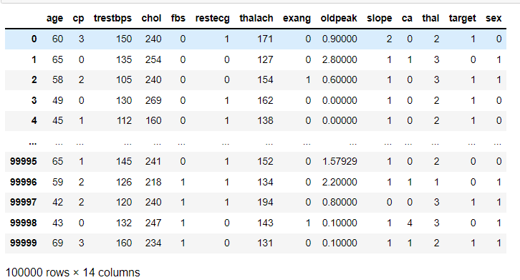
display data

Slide 7
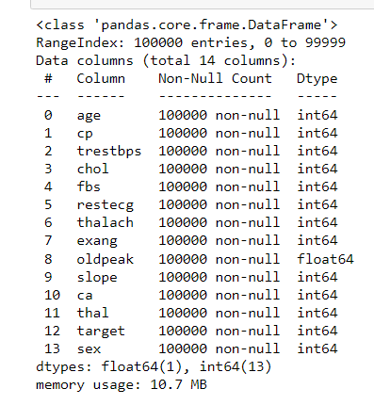
data inforantion

Slide 8
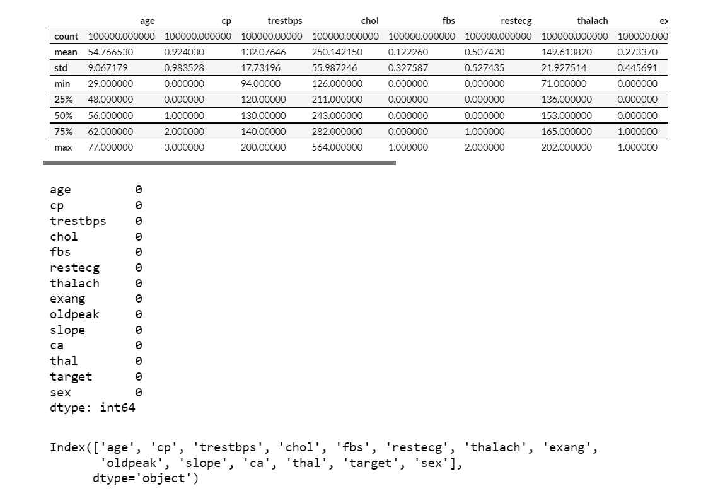
som statistic for data

Slide 9
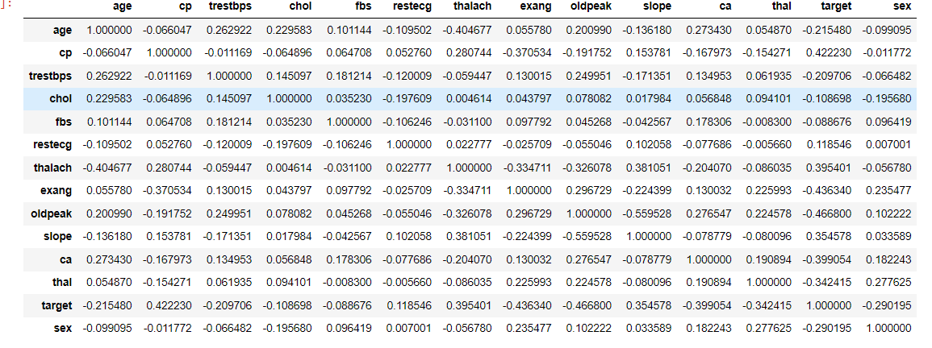
correlation between feature

Slide 10
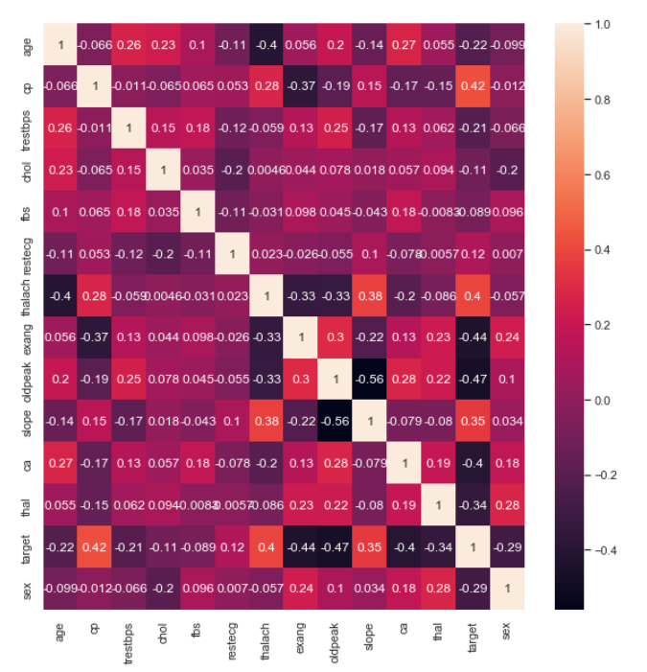
1- trestbps (resting blood pressure) and thalach (maximum heart rate achieved) are the strongest correlated factors with age. As a patient’s age increases, their resting blood pressure tends to increase and their maximum heart rate achieved tends to decrease.
2-Of particular interest is the row in the table for cardio, the diagnosis of heart disease. This row shows the correlation between cardio and the other health factors. Some of the factors with the strongest correlations to cardio are cp, thalach, exang, slope,oldpeak and slope which were defined in the Dataset Explanation section. While age and sex do not have as strong correlations to the cardio factor, this is not to say there are no conclusions that can be drawn from these factors. Analyzing how these factors interact with the cardio factor when evaluated in unison by looking at trends between groupings of both age and sex reveals additional information on how the age and sex of a patient can statistically contribute to the overall risk for cardiovascular disease.

Slide 11
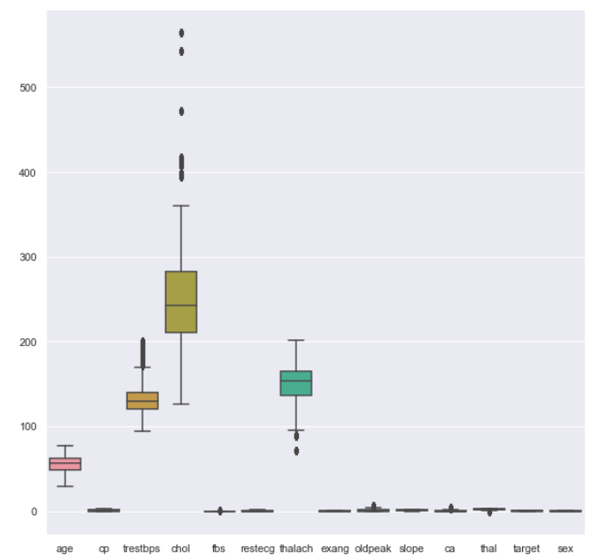
display and drop outliers

Slide 12
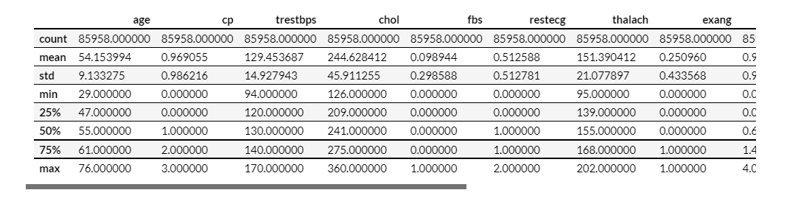
statistic of data after drop outliers

Slide 13
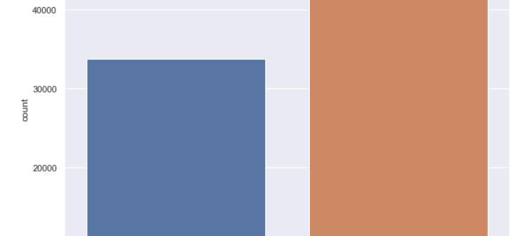
count of target for every class
People without disease are almost twice as much as infected people, and this indicates the quality of health services

Slide 14
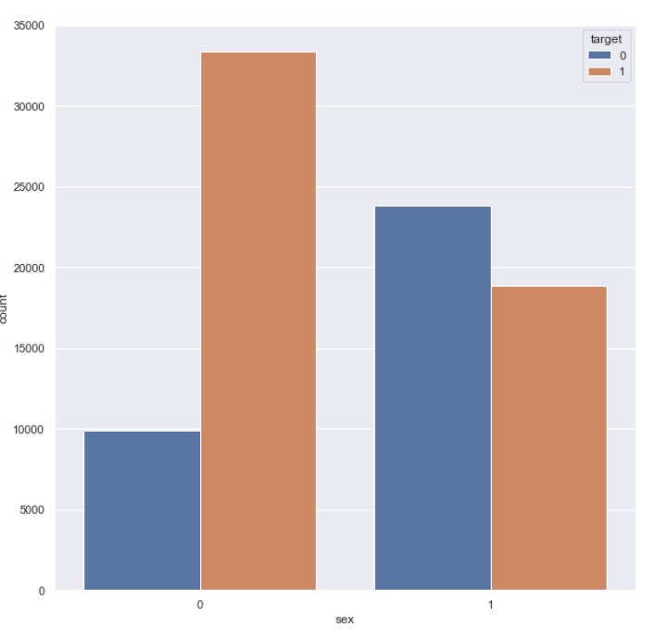
distribution sex according to target
Males with heart disease are nearly twice as likely as females

Slide 15
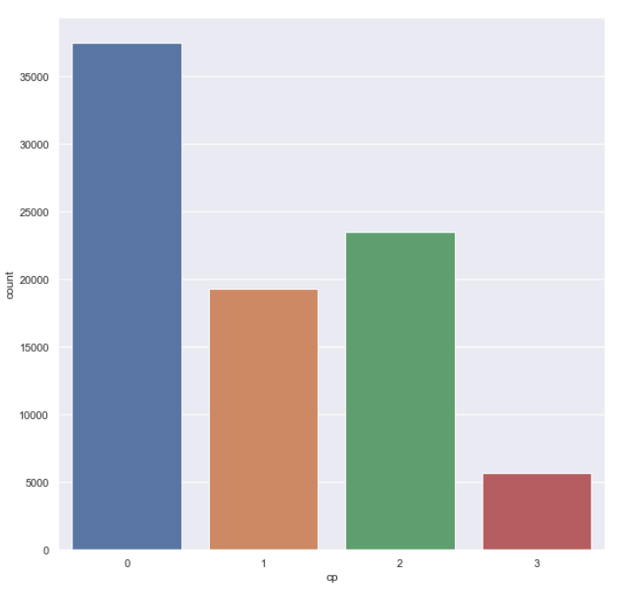
count of chest_pain for every class
The most common pain in chest pain is asymptomatic

Slide 16
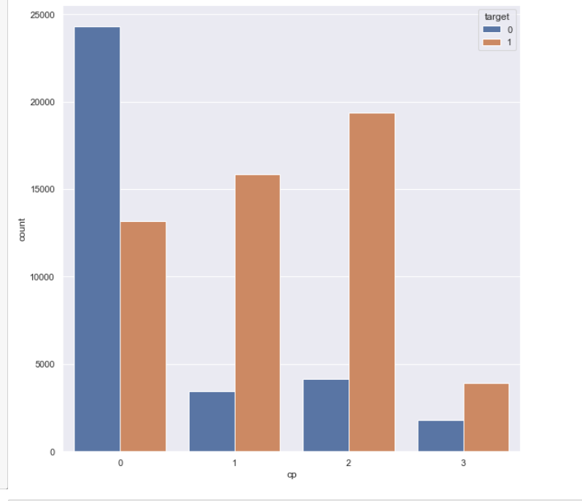
distribution chest_pain according to target
chest pain with type asymptomatic case the higher rate of heat disease and
chest pain with type typical angina case the less rate of heat disease

Slide 17
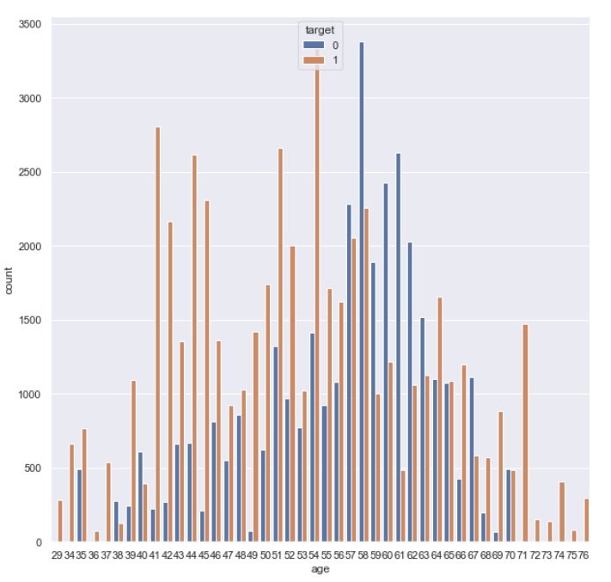
distribution age according to target
The ages of people with heart disease range from 57 and 70

Slide 18
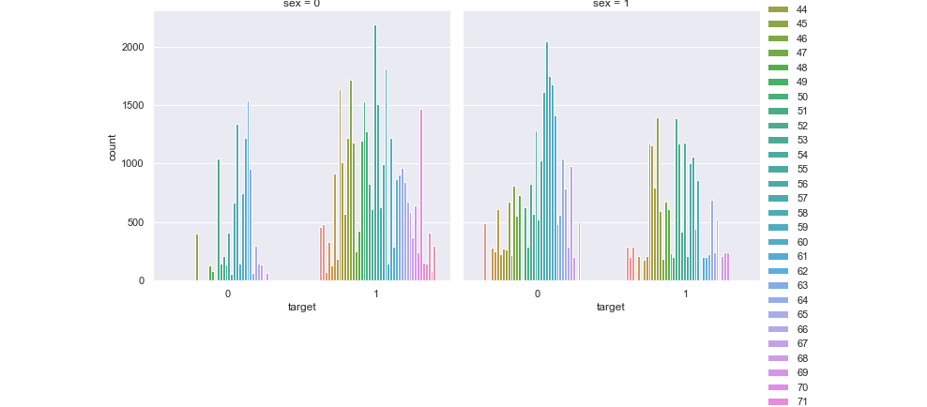
distribution targer according to age and sex
We see that for females who are suffering from the disease are older than males.

Slide 19
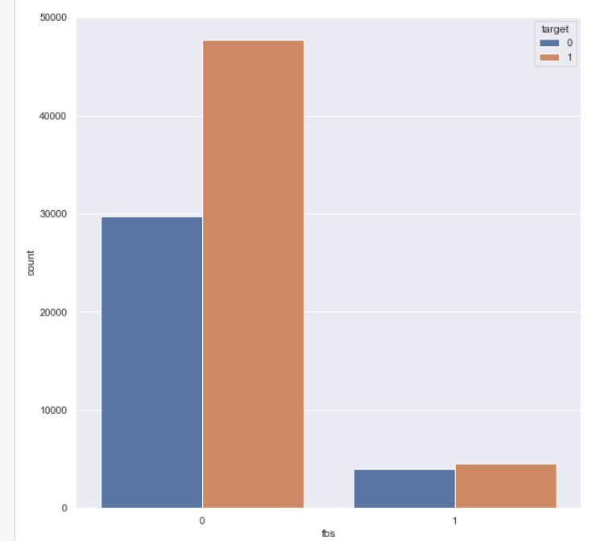
distribution Fasting Blood Sugar according to target
fbs might not be a strong feature differentiating between heart disease an non-disease patient

Slide 20
observation
Males are more susceptible to heart_disease than females
number of disease less than no disease
chest pain with type asymptomatic case the higher rate of heat disease
major people with age between 50 and 63 with heart diseas
fbs might not be a strong feature differentiating between heart disease an non-disease patient

Slide 21
recommendations
1-A medical examination should be done on the heart every period to ensure the health of the heart, especially men, because they are more susceptible to heart disease.
2-People with chest diseases should check for heart disease because they may be infected even when they do not feel symptoms
3-Heart diseases spread in the ages from 50 and above, so the elderly should follow the patient and maintain their comfort
4-It is not necessary for people with diabetes to worry about heart disease

